Slide 1
Distributed Network Programming
Prativa Nyaupane

Slide 2
Review
Email Handling using Java Mail API
Architecture of RMI

Slide 3
Outline
TCP
UDP
IP Address
Ports
Socket Programming using TCP and UDP
Working with URLs and URL Connection Class
Email Handling using Java Mail API
Architecture of RMI
Creating and Executing RMI applications
Architecture of CORBA
RMI vs CORBA
IDL and Simple CORBA Program

Slide 4
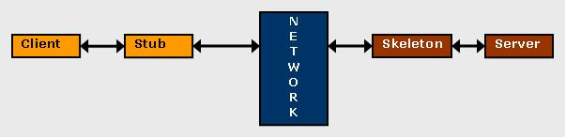
Remote Method Invocation
Remote Method Invocation(RMI) is an API that allows a Java object running on one virtual machine to invoke methods on an object running in another JVM.
This API provides a mechanism to build distributed applications in java.
The RMI provides remote communication between the applications using two objects stub and skeleton.
It is provided in the package java.rmi.*

Slide 5
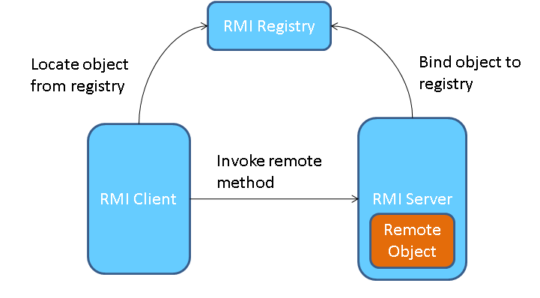
Architecture of RMI
In an RMI application, we write two programs, a server program (resides on the server) and a client program (resides on the client).
Inside the server program, a remote object is created and reference of that object is made available for the client (using the registry).
The client program requests the remote objects on the server and tries to invoke its methods.

Slide 6
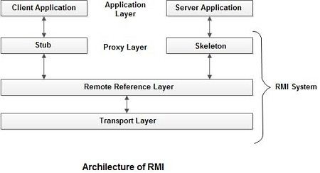
Architecture of RMI
Client/Server Application: The java programs that will communicate and pass information back and forth.
Stub: A stub is a representation (proxy) of the remote object at client. It resides in the client system; it acts as a gateway for the client program.
Skeleton − This is the object which resides on the server side. stub communicates with this skeleton to pass request to the remote object

Slide 7
Architecture of RMI (contd...)
RRL(Remote Reference Layer) − It is the layer which manages the references made by the client to the remote object
Transport Layer − This layer connects the client and the server. It manages the existing connection and also sets up new connections.

Slide 8
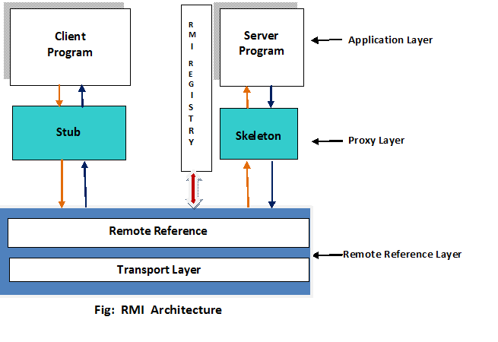
Working of an RMI Application
When the client makes a call to the remote object, it is received by the stub which eventually passes this request to the RRL(Remote Reference Layer).
When the client-side RRL receives the request, it invokes a method called invoke() of the object remoteRef. It passes the request to the RRL on the server side.
The RRL on the server side passes the request to the Skeleton (proxy on the server) which finally invokes the required object on the server.
The result is passed all the way back to the client

Slide 9
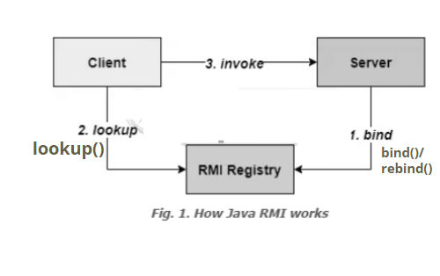
RMI Registry
RMI registry is a namespace on which all server objects are placed
Each time the server creates an object, it registers this object with the RMIregistry (using bind() or reBind() methods).
These are registered using a unique name known as bind name.
The client fetches the object from the registry using its bind name (using lookup() method).

Slide 10
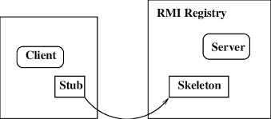
Stub vs Skeleton
Stub | Skeleton
The stub is an object, acts as a gateway for the client side. It resides at the client side and represents the remote object. | The skeleton is an object, acts as a gateway for the server side object.
All the outgoing requests are routed through it. | All the incoming requests are routed through it.
When the caller invokes method on the stub object, it does the following tasks: It initiates a connection with remote Virtual Machine (JVM) It writes and transmits (marshals) the parameters to the remote Virtual Machine (JVM), It waits for the result It reads (unmarshals) the return value or exception, and It finally, returns the value to the caller. | When the skeleton receives the incoming request, it does the following tasks: It reads the parameter for the remote method It invokes the method on the actual remote object, and It writes and transmits (marshals) the result to the caller.

Slide 11
Goals of RMI
To minimize the complexity of the application.
To preserve type safety.
Distributed garbage collection.
Minimize the difference between working with local and remote objects.

Slide 12
Creating and Executing RMI applications

Slide 13
Create an RMI application where a client can remotely invoke a method that send the sum of any two given integers.
This application has four main components:
1. SumInterface - remote interface provided by the server.
2. AddServerImpl.java - implements the remote interface
3. AddServer.java containts the main program from the servermachine
4. AddClient.java implements the client side of the distribute system
Source Code: https://drive.google.com/file/d/1h2LzKvBBqan7-j2rCl5Z9RCE_6k_AbrA/view?usp=drive_link

